Slide 1
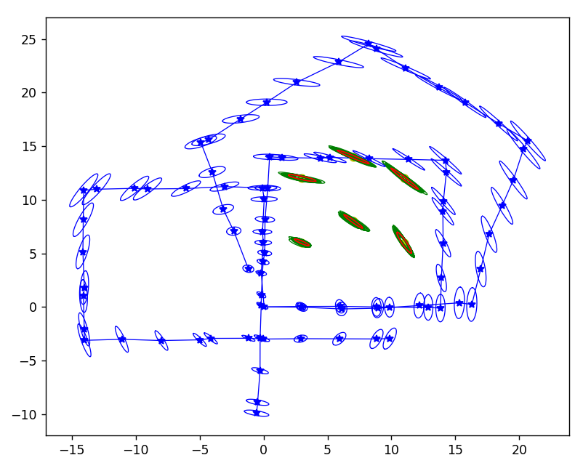

Multi-Agent SLAM Using Extended Kalman Filter
Course Name: 16-833 Robot Localization and Mapping
Team Members: Ryan Wu, Kevin Tang, Nithya Sampath, Tianqi Yu
Notes:
Ryan

Slide 2
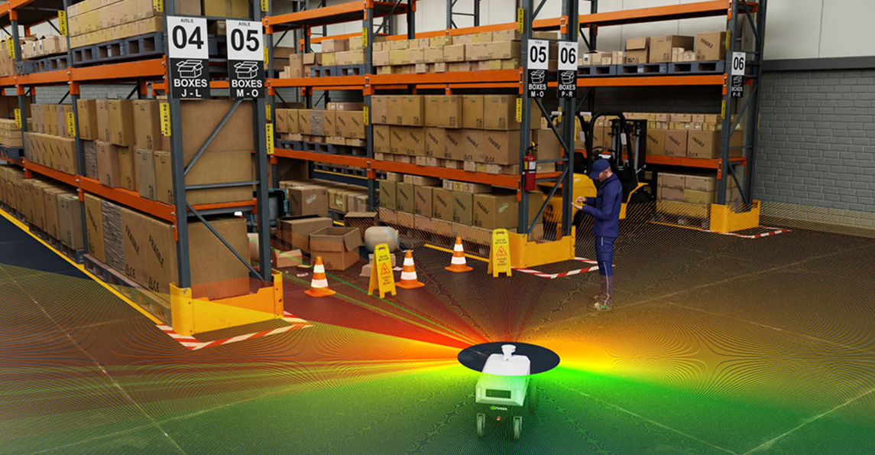
Agenda
01
Introduction & Motivation
02
Related Work
03
Algorithm
04
Evaluation
05
NVIDIA Isaac Visualization
06
Lesson Learned
Notes:
Ryan

Slide 3
Project Introduction & Motivation
The team took inspiration from HW2 and would like to extend the EKF’s capability to handle multiple agents and also provide a better visualization tool.
Our proposed method:
Generate synthetic datasets of the robot’s measurements and control data.
Solved the multi-agent problems using our multi-EKF solver.
Compare the estimation results between single agent and multi-agent.
Re-create the landmarks and robot motion in 3D using NVIDIA Isaac Sim.
Notes:
Kevin

Slide 4
Related Work

Slide 5
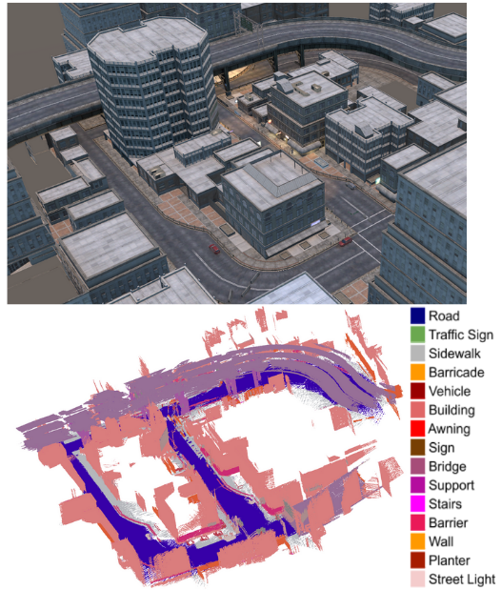
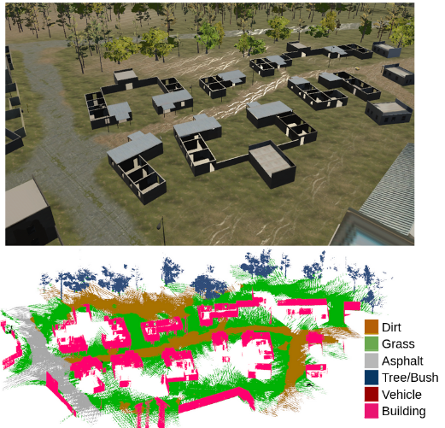
Kimera-Multi: Robust, Distributed, Dense Metric-Semantic SLAM for Multi-Robot Systems
Kimera-Multi
A fully distributed, fully modular multi-robot system for robust and dense metric-semantic SLAM.
A framework capable of identifying and rejecting incorrect inter/intra-robot loop closures.
Advantages to other multi-agent frameworks
A more robust and accurate trajectory estimation.
Generates 3D meshes with improved metric-semantic accuracy.
Significant robot communication reductions and increased efficiency.
Can achieve estimation errors comparable to centralized SLAM systems.
Tian, Y., Chang, Y., Arias, F. H., Nieto-Granda, C., How, J. P., & Carlone, L. (2021). Kimera-Multi: Robust, Distributed, Dense Metric-Semantic SLAM for Multi-Robot Systems (arXiv:2106.14386). arXiv. http://arxiv.org/abs/2106.14386
Notes:
Ryan

Slide 6
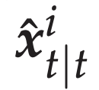
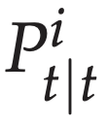
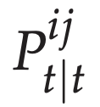
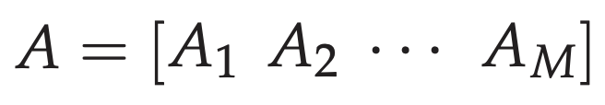
Multi-Robot SLAM via Information Fusion (Extended Kalman Filter)
Information Fusion Method
Our method is adapted from Sasaoka, et. al’s information fusion technique.
Main Steps:
1. The robots compute (and maintain) state estimates and covariance matrices based on their individual measurements.
2. Collect all of the state estimates (after each robot has performed its update step) to compute cross-covariance matrices .
3. Find optimal weight matrices which will be multiplied by the post-update state estimates to obtain a final global state estimate.
Although our implemented method is still a weighted average method, it deviates from the paper’s method slightly in that we (1) do not attempt to track the positions of other agents, and (2) use scalar weight values computed based on the covariance.
Sasaoka, T., Kimoto, I., Kishimoto, Y., Takaba, K., & Nakashima, H. (2016). Multi-robot slam via information fusion extended kalman filters. IFAC-PapersOnLine, 49(22), 303–308. https://doi.org/10.1016/j.ifacol.2016.10.414
Notes:
Nithya

Slide 7
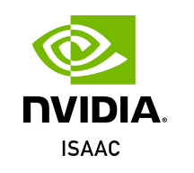
Algorithm
Generate data and noise in 2D Simulation
Move on to the next step
Perform 1 step of EKF
Agent 0
Compute global variance estimation
Perform 1 step of EKF
Agent 1
Compute weight matrix from covariance matrix
Visualize in NVIDIA Isaac
.
.
.
Update global estimate with the weighted average of individual estimates
Perform 1 step of EKF
Agent N
Notes:
Kevin

Slide 8
Evaluation

Slide 9
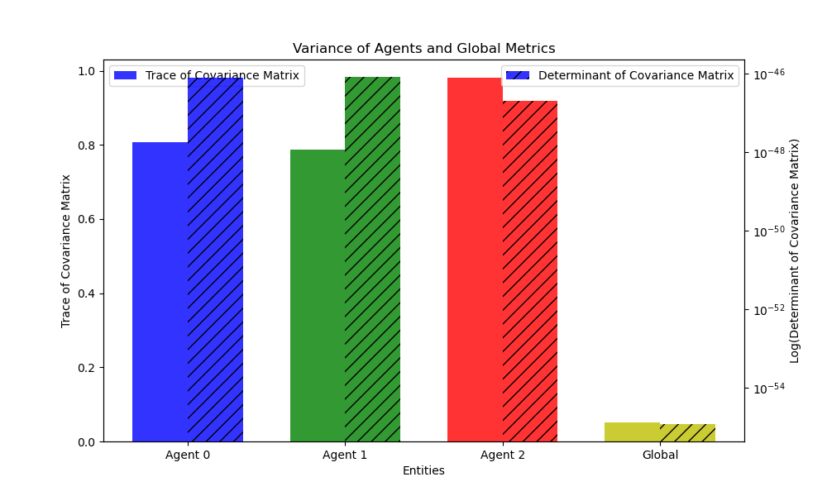
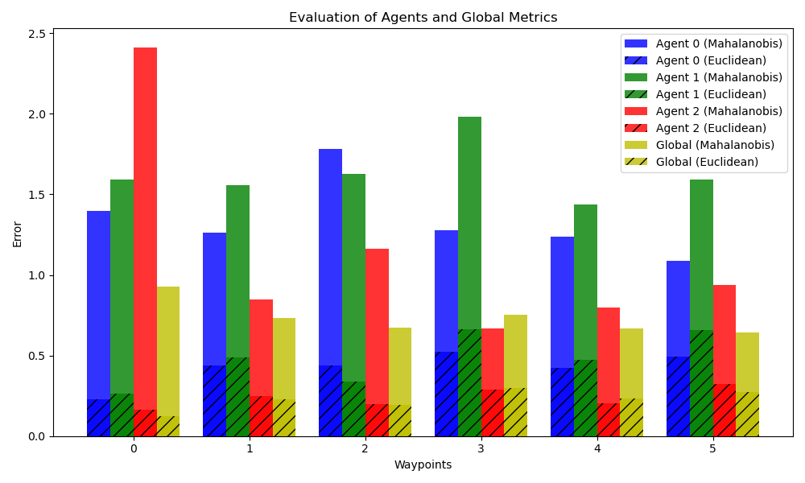
Evaluation: constant measurement noise
Metrics:
Compare the trace of the covariance matrix.
Compare the determinant of the covariance matrix.
Compare the Euclidean error and Mahalanobis error.
Notes:
Tianqi

Slide 10
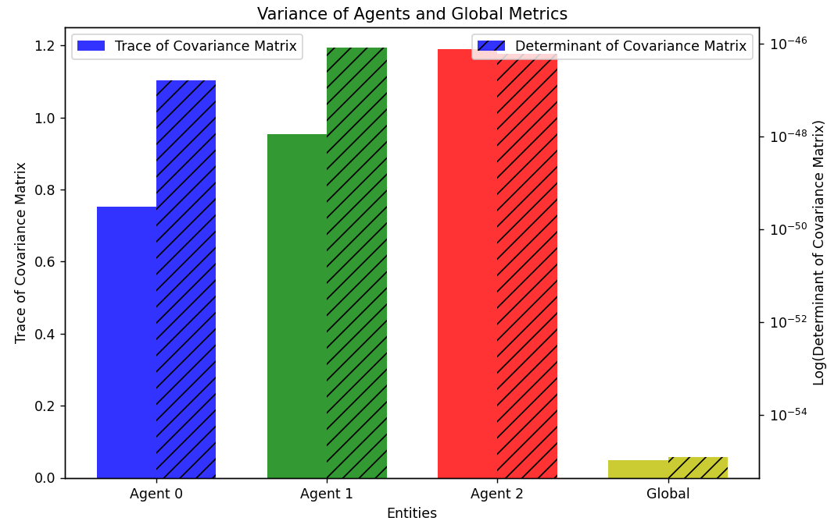
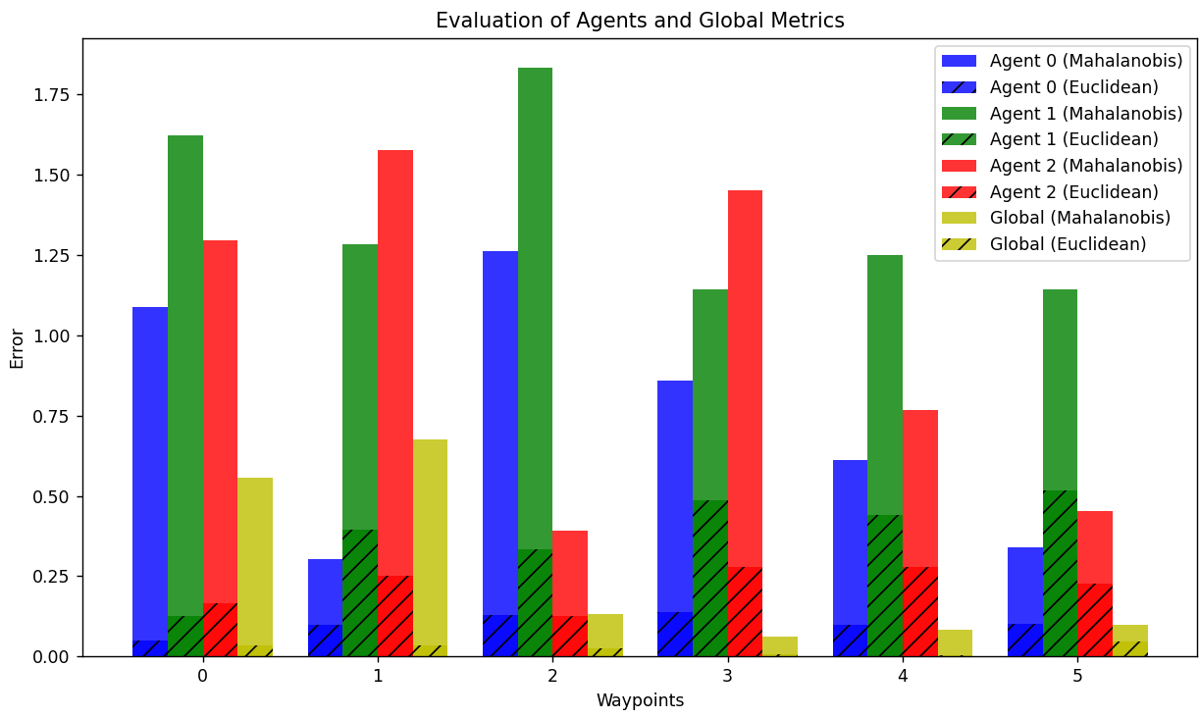
Evaluation: varying measurement noise
The same metrics used but with different measurement noise:
Agent0: low noise.
Agent1: standard noise.
Agent2: high noise.
Notes:
Tianqi

Slide 11
Evaluation: varying measurement noise
Comparing Multi-EKF estimated landmark positions to ground truth:
Landmark number | Landmark’s ground truth x, y | Agent0’s x, y (Single-agent EKF) | Agent1’s x, y (Single-agent EKF) | Agent2’s x, y (Single-agent EKF) | Landmark’s x, y (Multi-agent EKF)
1 | 3, 6 | 2.988, 5.951 | 3.126,6.005 | 2.871, 6.104 | 2.988, 6.031
2 | 3, 12 | 2.906, 12.028 | 3.388, 11.931 | 2.779, 12.118 | 3.010, 12.034
3 | 7, 8 | 6.946, 8.116 | 7.215, 7.745 | 6.902, 8.078 | 7.015, 7.981
4 | 7, 14 | 6.864, 14.028 | 7.425, 13.765 | 6.772, 14.162 | 7.006, 14
5 | 11, 6 | 10.923, 6.061 | 11.204, 5.611 | 10.882, 6.254 | 10.996, 5.997
6 | 11, 12 | 10.919, 12.059 | 11.389, 11.659 | 10.830, 12.149 | 11.032, 11.969
Notes:
Tianqi

Slide 12
NVIDIA Isaac Sim

Slide 13
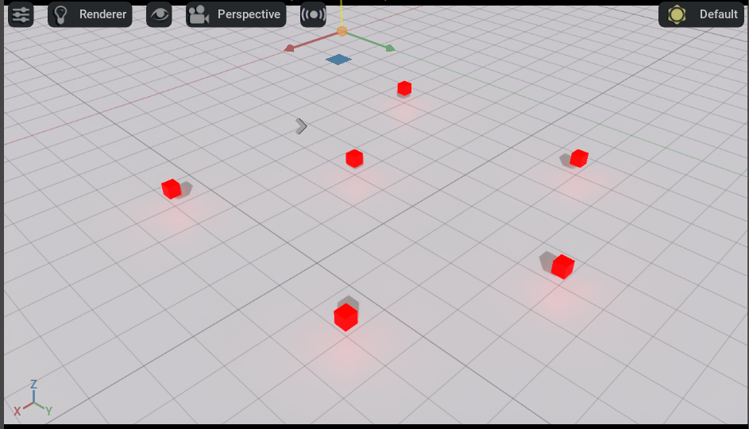
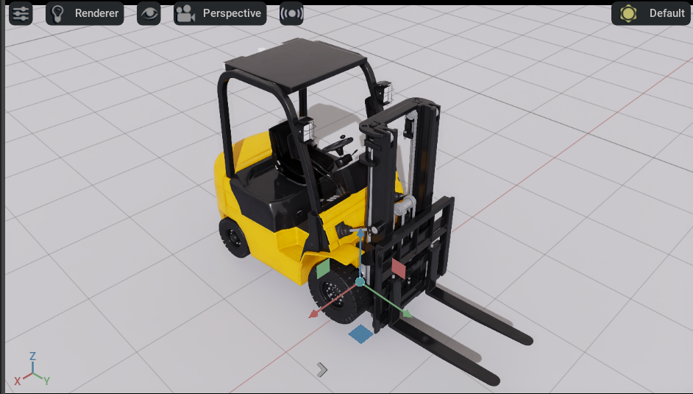
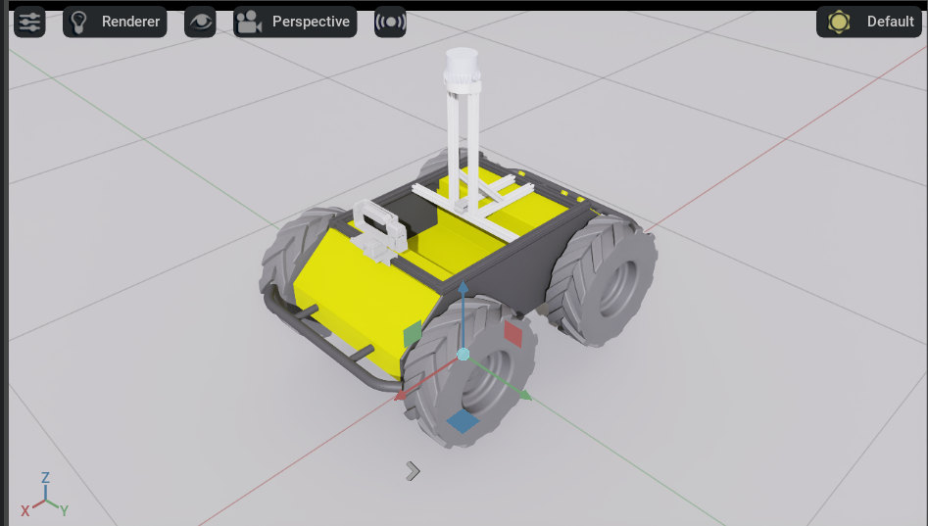
NVIDIA Isaac Sim Visualization (1/2)
The simulation environment setup:
Ground truth landmarks
Agent: Forklift
Agent: Theia UGV
Notes:
Ryan

Slide 14
NVIDIA Isaac Sim Visualization (2/2)
The simulation animation for both agents running different control inputs:
Notes:
Ryan

Slide 15
Lesson Learned
The Good:
Multi-agent gave us better landmark estimation compared to single-agent.
Explored the state-of-the-art frameworks in the multi-agent SLAM space.
Experienced with a powerful 3D visualization tool for robotic research.
The Not so Good:
Data fusion and association problem for multi-agent system.
Lack the practical experience in generating datasets for SLAM operations.
Creating 2D datasets from 3D is not trivial (quaternion math).
Using naive global covariance generation method for result evaluation.
Notes:
Nithya

Slide 16
Thank you for your time!
Questions?

